Slide 1
Imágenes paralelas
Agrega información de bobinas

Slide 2
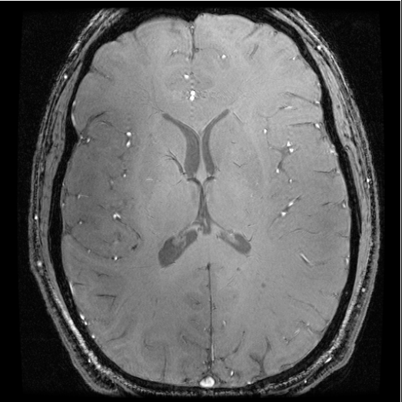
Multi-coil imaging
Coil 2
Coil 1
Coil 3
Coil 4

Slide 3
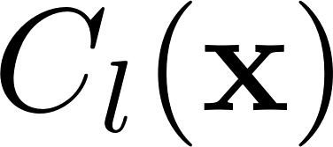


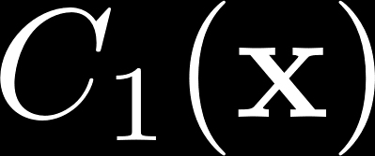
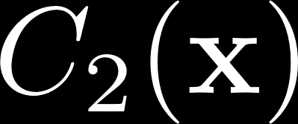


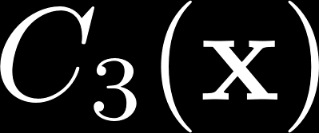
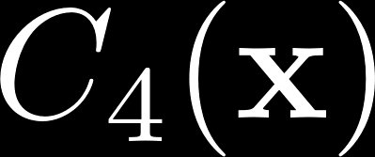
Coil sensitivity:

Slide 4
Image reconstructed from each coil
Coil sensitivity (magnitude and phase)
Object
Noise (coil dependent)

Slide 5
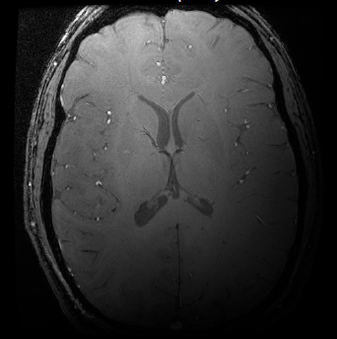
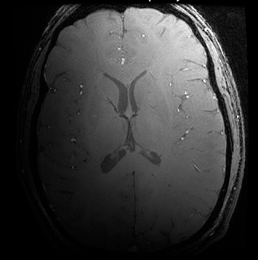
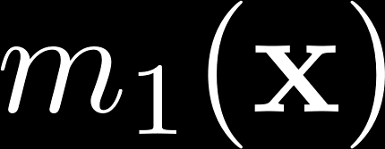
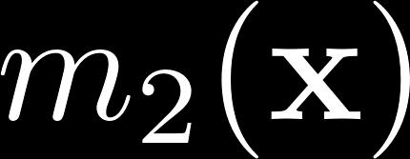
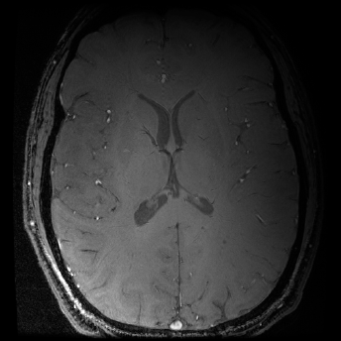
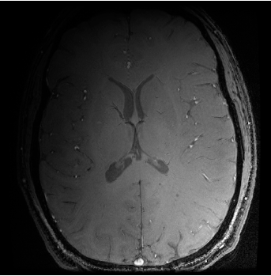
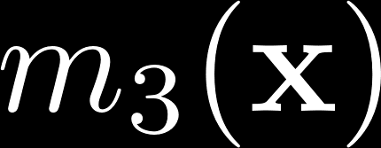
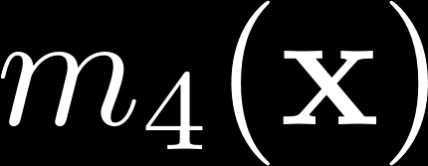
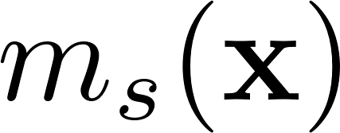
Images per coil
?

Slide 6

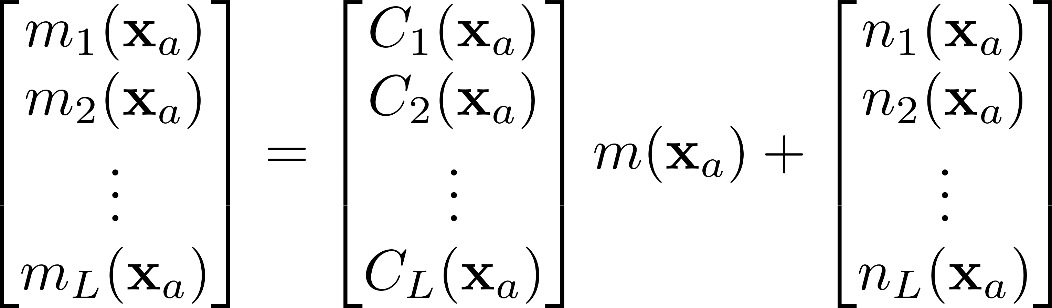
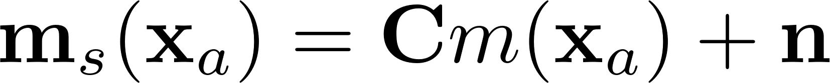
Pixel per pixel reconstruction
For pixel
And putting together the information of each coil:

Slide 7

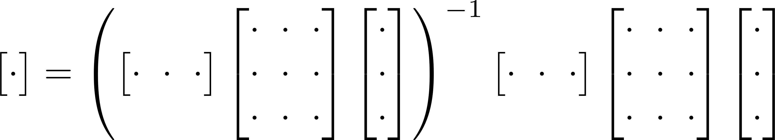
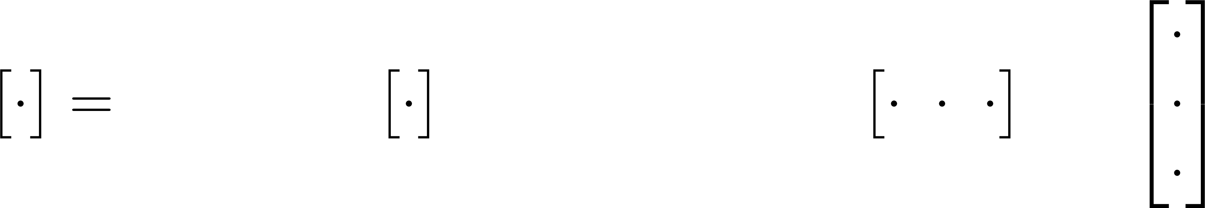
Pixel per pixel reconstruction
Let be the noise correlation, inverting
for minimum covariance is

Slide 8
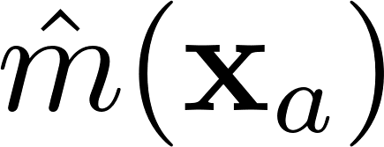
Pixel per pixel reconstruction
Let be the noise correlation, inverting
for minimum covariance is
Covariance of
Much less than noise in each coil

Slide 9

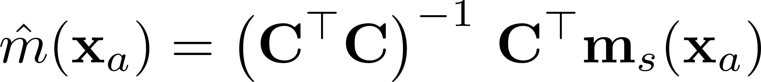
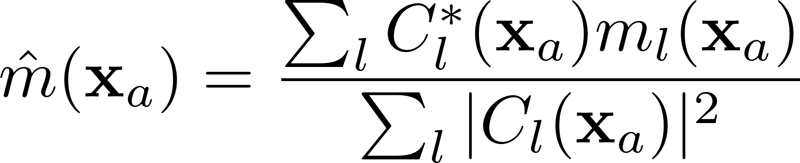
Pixel per pixel reconstruction
If
Intensity correction
Phase correction
This is known as Sum of Squares (SS)

Slide 10
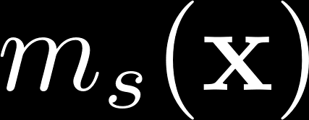
Images per coil

Slide 11
Imágenes paralelas

Slide 12
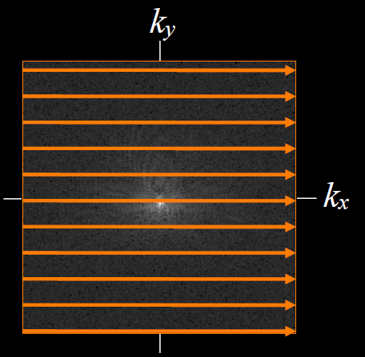
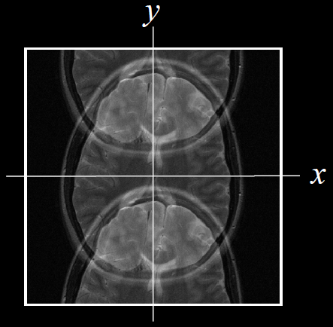
Usar información de bobinas
La ambigüedad del submuestreo puede ser compensada con la redundancia de información de las bobinas

Slide 13
Imágenes paralelas
En el dominio de la imagen
SENSE
En el dominio de Fourier
SMASH, GRAPPA

Slide 14
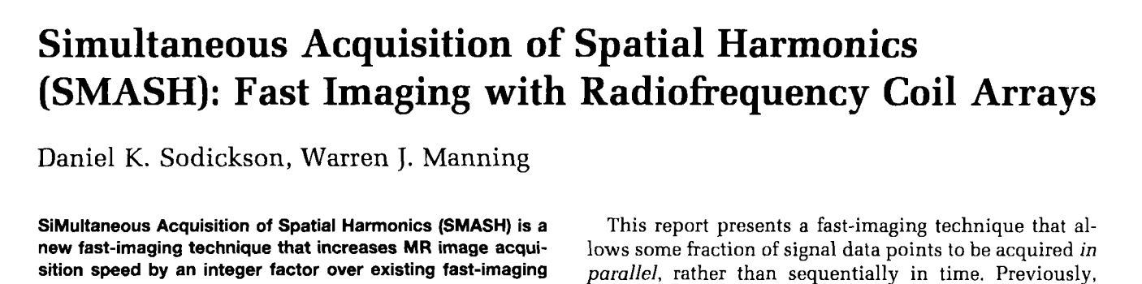
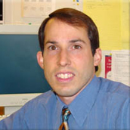
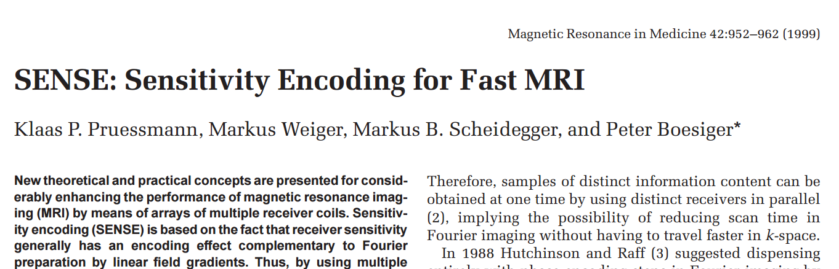
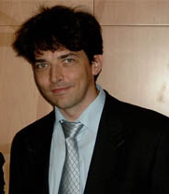
Parallel Imaging: hardware and maths
Daniel K. Sodickson
1997
Klaas P. Pruessmann 1999

Slide 15
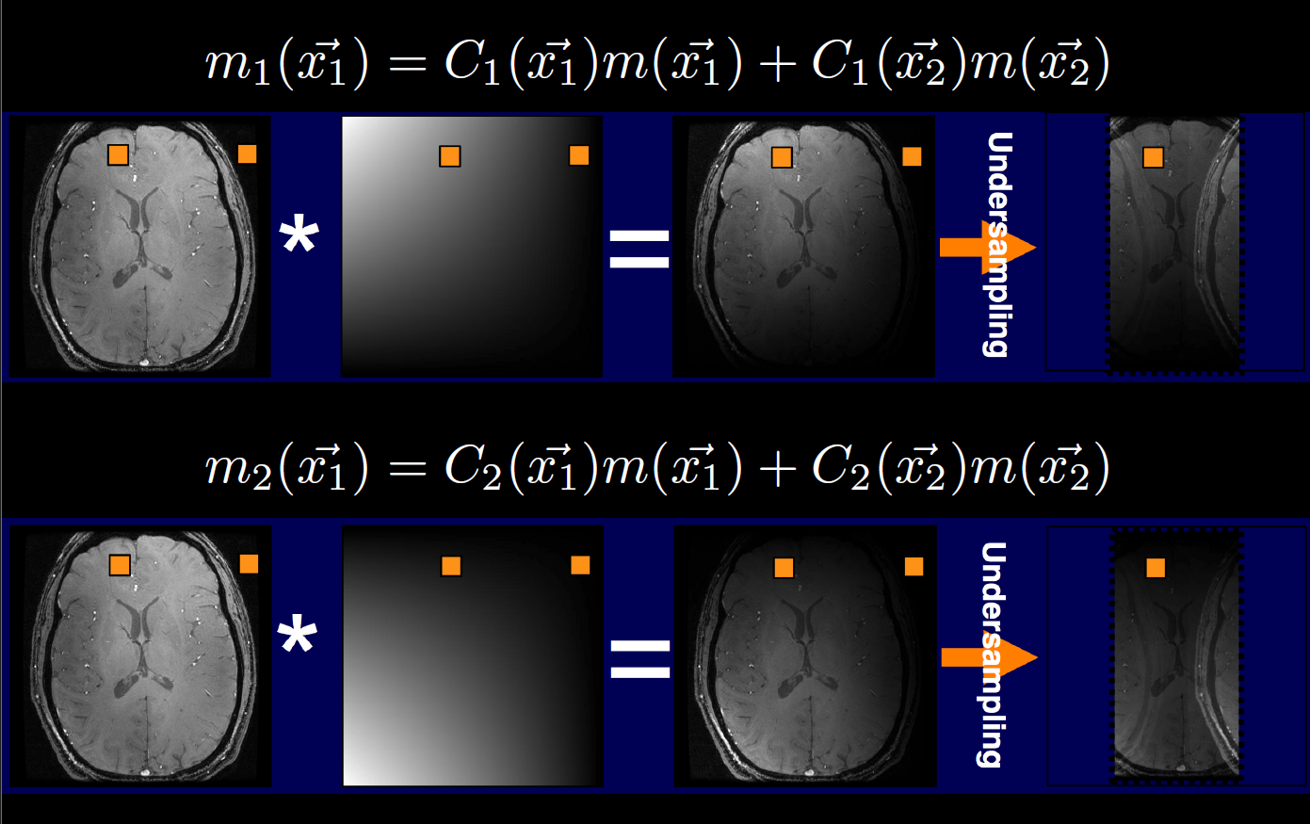
Submuestreo introduce ambigüedad
Kyung Sung, Advanced Topics in MRI

Slide 16
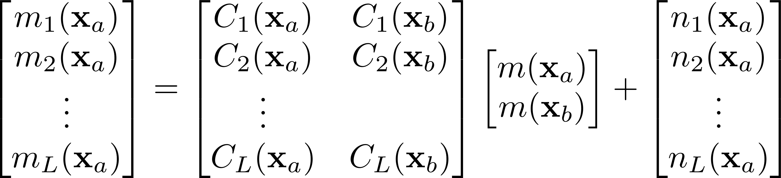

Two-fold undersampling
Solve for two unknowns and L equation

Slide 17
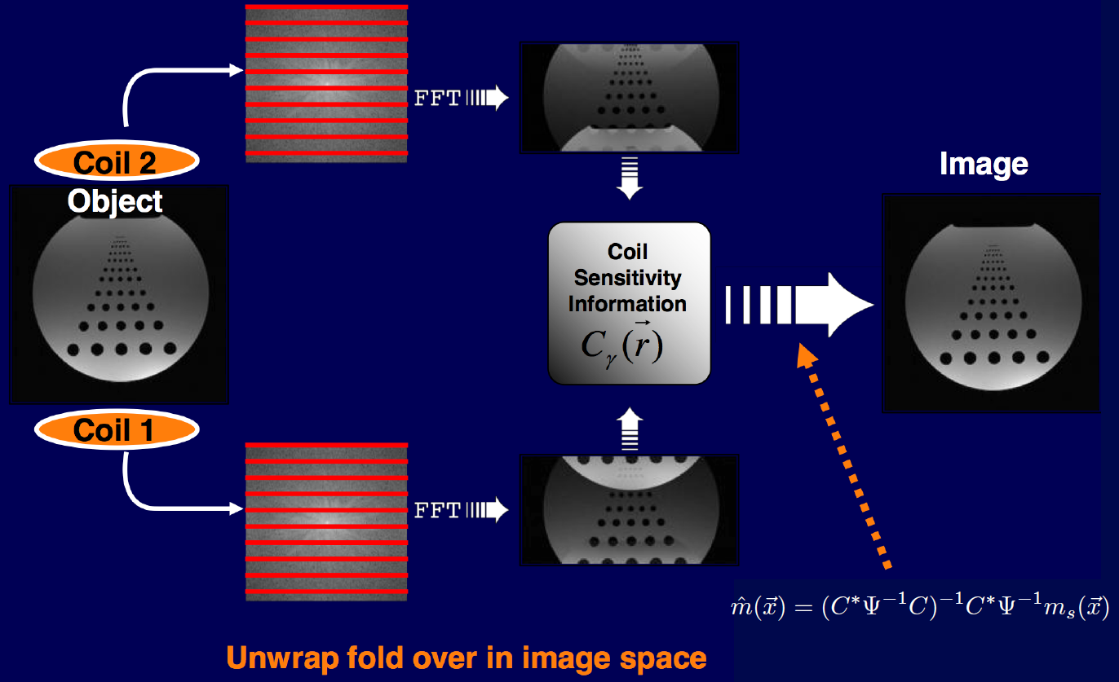
SENSE Reconstruction
Kyung Sung, Advanced Topics in MRI

Slide 18
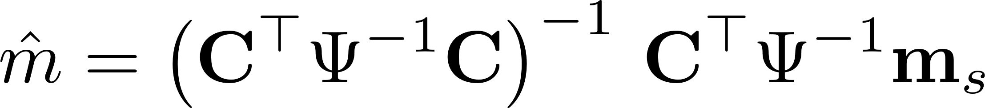
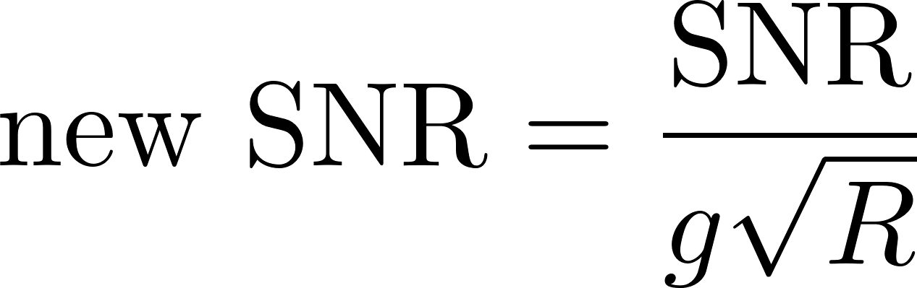
Solves RxR inverse system per pixel
Undersampling factor R limits:
SNR loss mechanisms
Reduced scan time
SENSE condition: geometric factor g

Slide 19
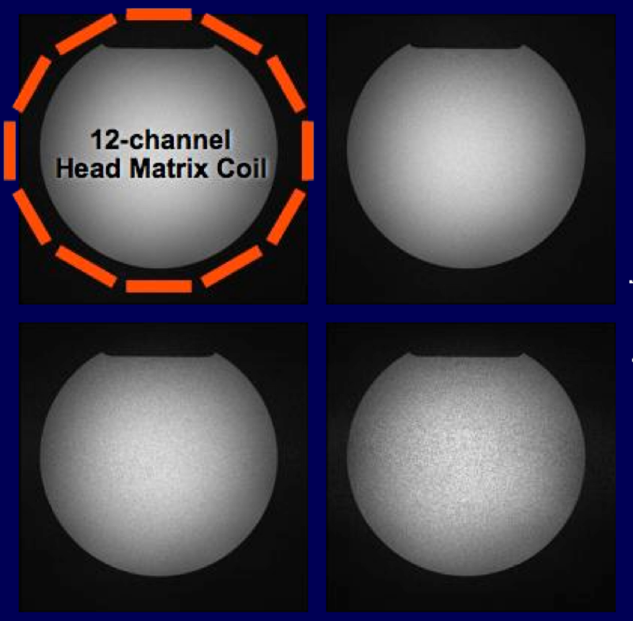




Noise

Slide 20
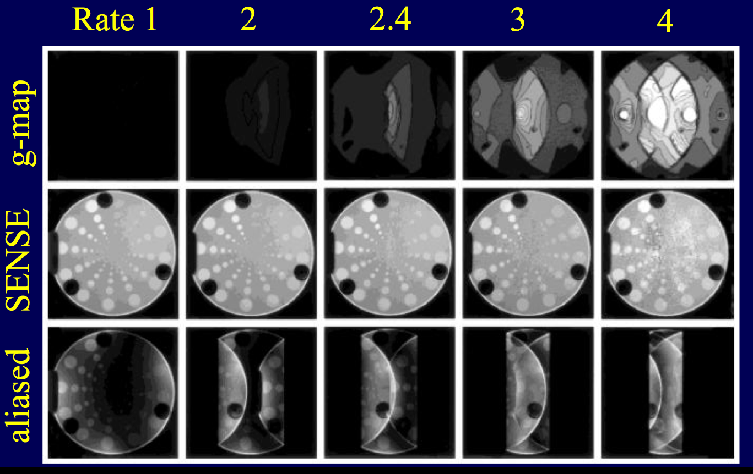
g maps for different R’s

Slide 21
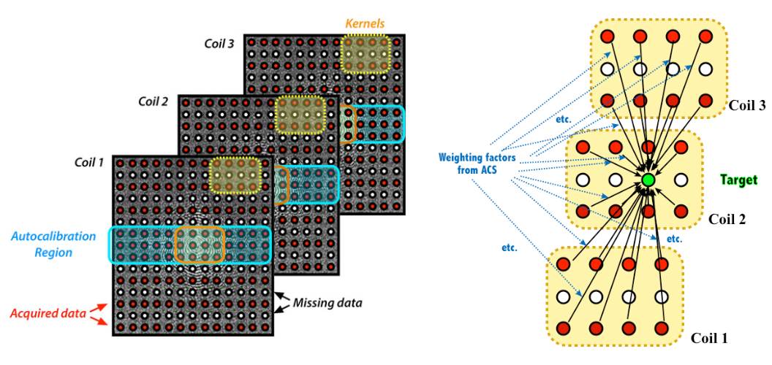
GRAPPA (in k-space domain)
Mriquestions.com

Slide 22
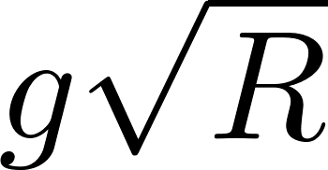
Conclussions
Aliasing from undersampling can be unfold by employing multi-coil redundancy.
In image space: SENSE
In k-space: SMASH and GRAPPA
Accelaration factor: R (typically 2 to 5)
SNR loss of

